Slide 1





Cafe Management System
Good morning, but coffee first
Group Members:
Iqra Agha | 01-134251-026
Meerab Hanif | 01-134251-041

Slide 2

Introduction
Purpose: Automate cafe operations efficiently.
Key Features:
Staff & Admin management
Customer order processing
Inventory tracking
Feedback management
Reporting and analytics
Graphical user interface for ease of use

Slide 3
System Architecture
Components:
User Classes: Admin, Staff, Customer
Inventory & Menu Management
Orders & Billing
Feedback Management
Reports & Analytics

Slide 4


Class Design
User
Login, logout, change password
Admin
Manage staff, menu, inventory, view feedback
Staff
Create & update orders, check inventory
Customer Place order, give feedback
MenuItem & InventoryManager
Track menu items and stock
Order & Billing
Process orders & generate receipts
Feedback Manager
Handle customer feedback

Slide 5
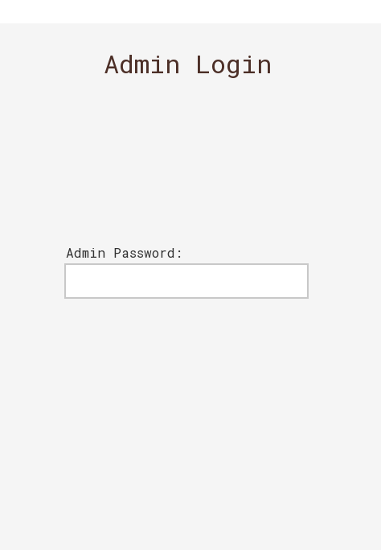
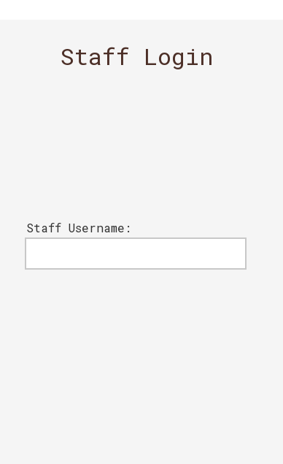
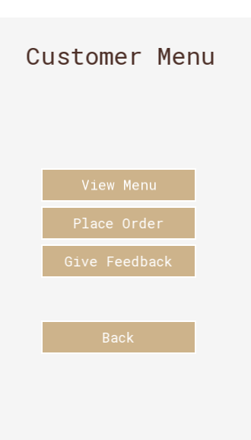
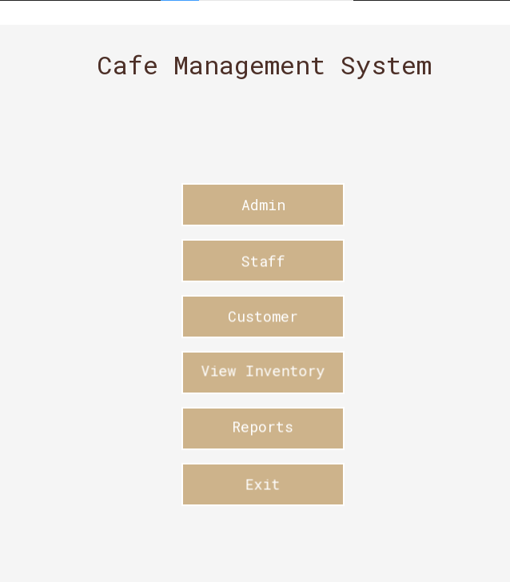
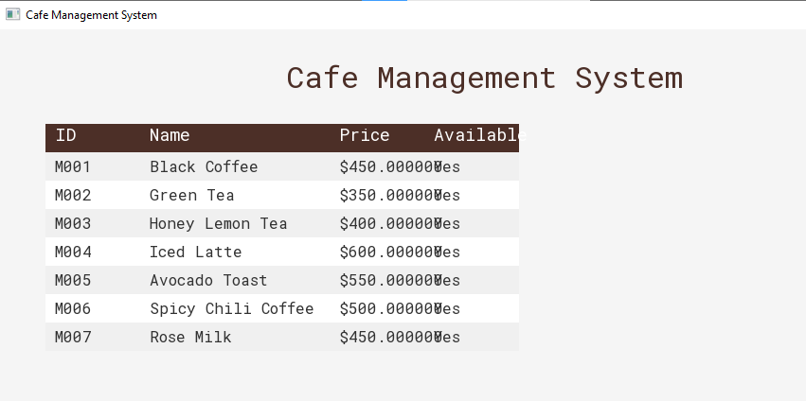
GUI Overview
Login/Logout
screen
Admin
Dashboard
Staff Order
Screen
Customer Order
&
Feedback Screen
Inventory & Menu Management Screens

Slide 6
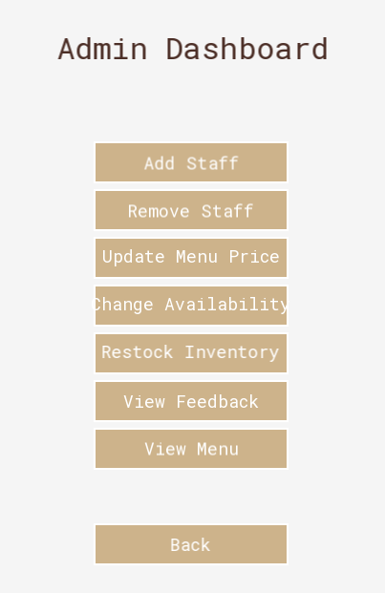
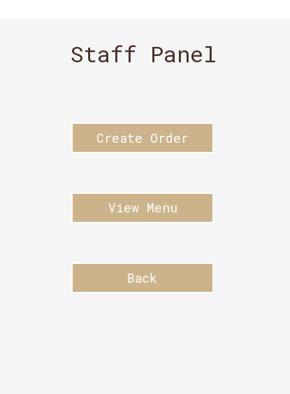
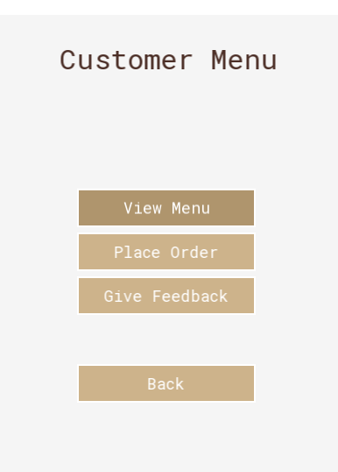
Screenshots of GUI
Admin Dashboard
Customer Order
&
Feedback screen
Staff order Screen

Slide 7



Our Cafe

Slide 8
Demo Video
Kimmy

Slide 9



GitHub Repository
https://github.com/Iqra039/Cafe-Management-System
https://github.com/scriptveil/Cafe-Management-System.git

Slide 10


Thank You
Borcelle

